Slide 1

Sales Performance Analysis 2021-2024
Strategic Insights for Growth
08-01-2025
Bruno Lucciano Villegas Volpi Iagobuche
Data Engineer

Slide 2
What We'll Cover Today
Business Snapshot – Where we are
Key Discoveries – What the data reveals
Growth Opportunities – Where we can go
Strategic Recomendations – How to get there

Slide 3
Our Business at a Glance
Revenue Growth
+150% (2021-2023)
From $6M to $15M
Operacional Excelence
5 days delivery
99% consistency
Sales Volume
121.317 transactions
31.465 orders
Market Shift
Red → Black → Yellow
Emerging New Trend

Slide 4
Impressive Growth Trajectory
133%
7%
Partial
YTD
(January-May)
Key Insight: Explosive growth in 2022, stabilization in 2023

Slide 5
Color Drives Success
Partial Year
29$M Sales

Slide 6
Consistent Delivery is Our Competitive Edge
5.01 days
Average delivery time for ALL categories

Slide 7
Data Quality Drives Business Value
Before Enhancement
190 products without category (63%)
Innacurate analytics
Lost revenue attribution
After Enhancement
Only 46 uncategorized (15%)
85% properly categorized
Clear revenue tracking
Better decision enabled
Key Result: 144 products automatically categorized = $108.8M revenue now trackable by category

Slide 8
What Needs Immediate Attention
Operational Outlier
26-day delivery found
Bikes: 0.2% of orders
Uncategorized Products
46 products = 15% of catalog
Impact:
Revenue Risk
67% from one color (Black)
Components: 0.1% of orders
Root cause unknown
Missed sales opportunities
Poor customer experience
Risk realized:
$8.5M drop in transitions
Red → Yellow shift
Need diversification

Slide 9
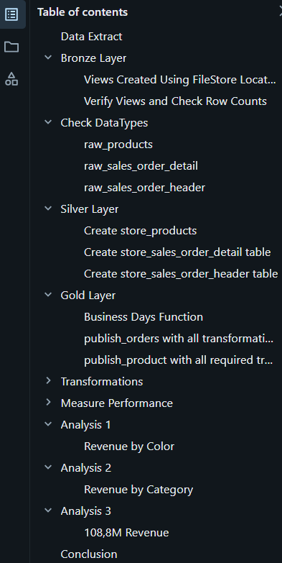
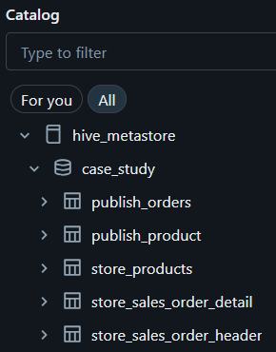
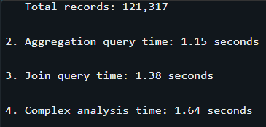
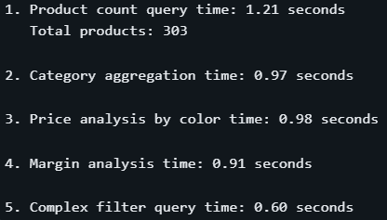
Query Performance:
- publish_orders
Trackeable Back-End
Organized Catalog
Query Performance:
- publish_orders

Slide 10





Thank you for your time. I hope this presentation has served you well.

